Slide 1
CS152 Discussion Section 2
Pipelining

Slide 2
Agenda
Iron Law
Pipelining
Hazards
Alternative pipeline organizations
Exceptions

Slide 3
Administrivia
Problem Set 1 due Mon Feb 8
Lab 1 due Wed Feb 17
Problem Set 2 to be released Wed Feb 10

Slide 4
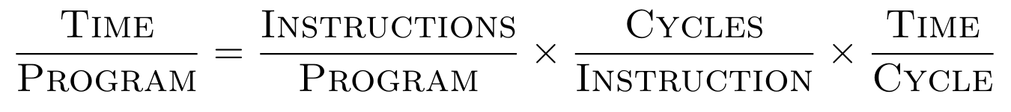
Iron Law of Processor Performance
What are different techniques to improve each term?
Instructions/Program | Cycles/Instruction (CPI = 1/IPC) | Time/Cycle (1/Hz)
Notes:
Most important equation in CS152

Slide 5
Iron Law
Case 1: In a classic RISC pipeline, modify the ISA (and thus the microarchitecture) to use hardware interlocking instead of software interlocking for both branch delay slots and load-use delay slots [Quiz 1, 2011]
Instructions/program:
CPI:
Cycle time:

Slide 6
Iron Law
Case 2: Remove hardware floating-point instructions and instead use software subroutines for floating-point arithmetic [Quiz 1, 2013]
Instructions/program:
CPI:
Cycle time:

Slide 7
Data Hazards
Read-After-Write (RAW)
Write-After-Read (WAR)
Write-After-Write (WAW)
Why is RAW the only data hazard in the classic 5-stage RISC pipeline?
ADD x1, x2, x3 SW x4, 4(x1)
ADD x1, x2, x3 SUB x2, x4, x5
ADD x1, x2, x3 SUB x1, x4, x5

Slide 8
Data Hazards
RAW | WAR | WAW
Identify all potential hazards:
ADDI x1, x0, 4 SW x1, 8(x2) SLLI x3, x1, 1 ADD x2, x1, x3 LW x1, 0(x3)

Slide 9
Structural Hazards
Are there any structural hazards in a classic 5-stage RISC pipeline? What about the single-bus microcoded machine?
What modifications to a RISC pipeline may introduce a structural hazard?

Slide 10
Pipelining
Inst | x1 | x2
addi | ? | 0x700
add | 0x700 | 0x700
lw
bne
Memory Address | Memory Value
0x400 | 0x000
0x404 | 0xD40
...
0x700 | 0x9F0
0x704 | 0x400
...
0x9F0 | 0x400
0x9F4 | 0x000
...
0xD40 | 0x000
0xD44 | 0x9F0
What does the following code do? How many iterations does it run?
ADDI x2, x0, 0x700 LOOP: ADD x1, x2, x0 LW x2, 4(x2) BNE x2, x0, LOOP

Slide 11
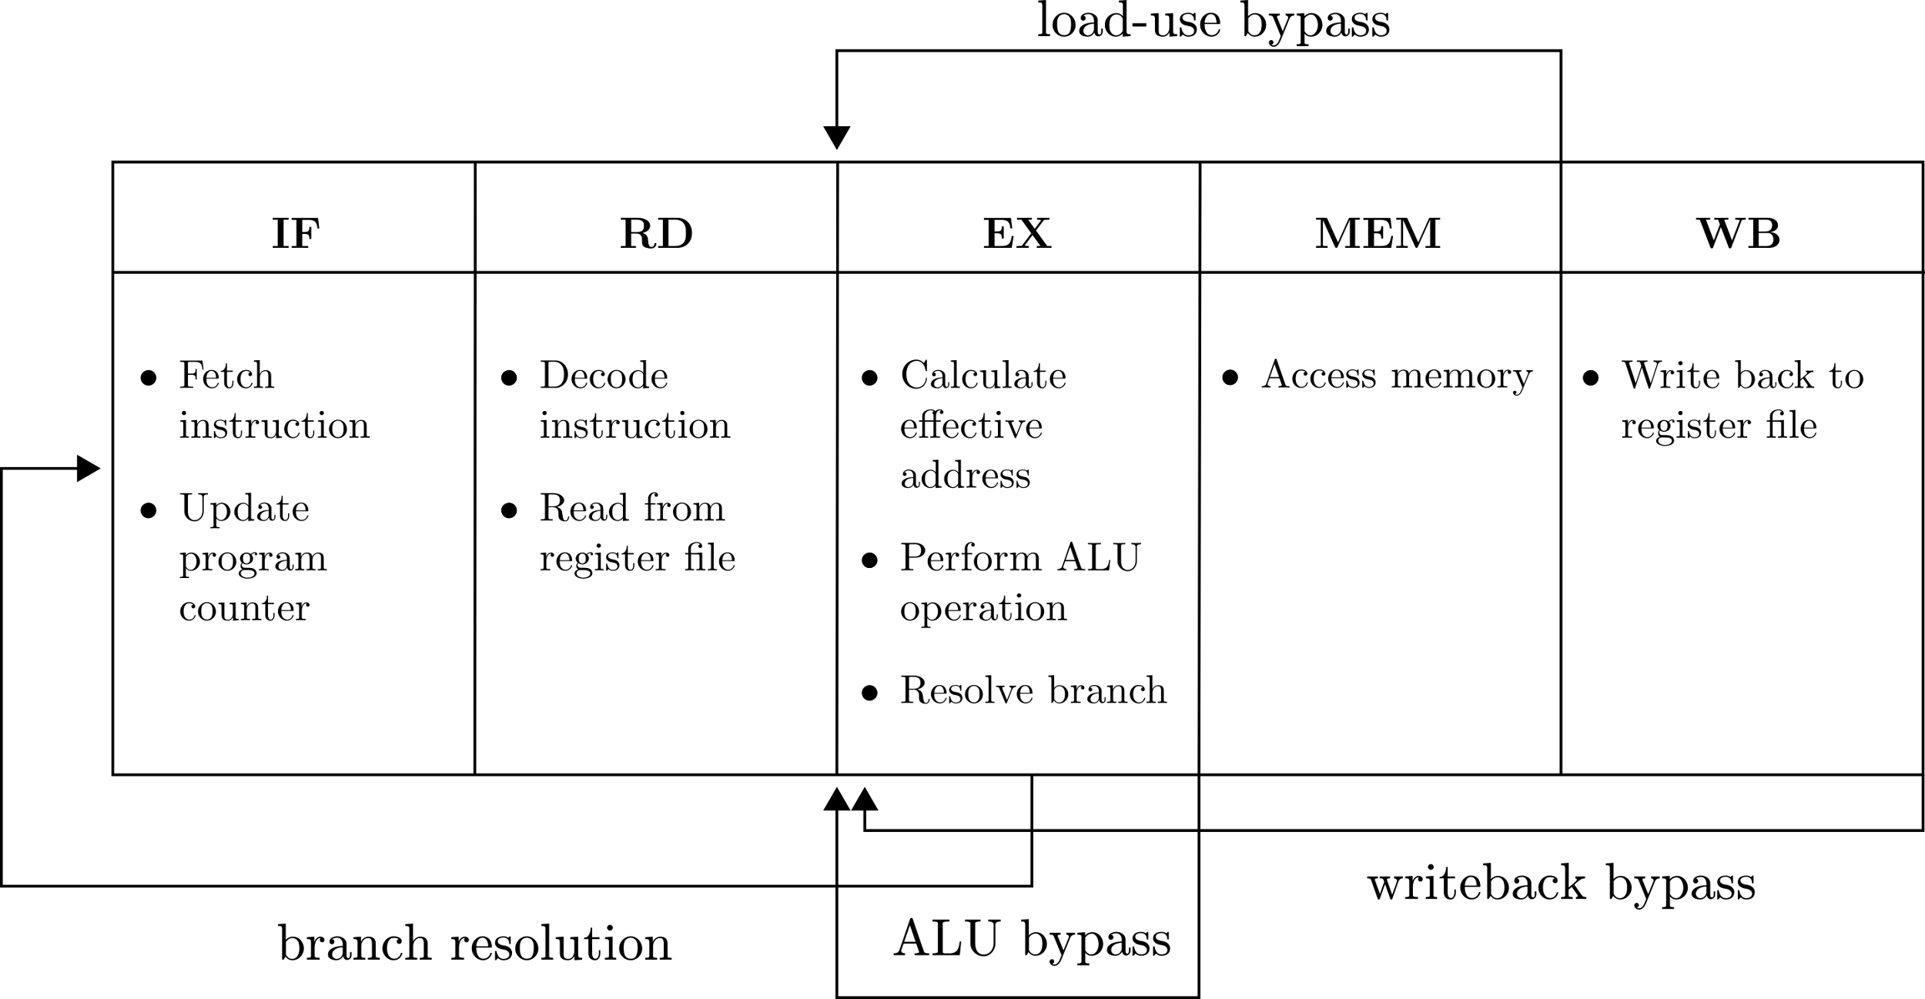
Classic RISC (Load-Use Interlock)
Fill in the pipeline diagram (What is the branch penalty?)

Slide 12
 | 1 | 2 | 3 | 4 | 5 | 6 | 7 | 8 | 9 | 10 | 11 | 12 | 13 | 14 | 15 | 16 | 17 | 18 | 19 | 20 | 21 | 22 | 23 | 24 | 25 | 26 | 27 | 28 | 29 | 30
addi
add
lw
bne

Slide 13
Classic RISC (Load-Use Interlock)
What is the CPI for the pointer chase code on the LUI pipeline? (CPI is measured from when first instruction commits to when last instruction in the sequence commits)
What is the CPI if MEM is split into M1 and M2?
What is the CPI assuming the BNE is always predicted correctly?

Slide 14
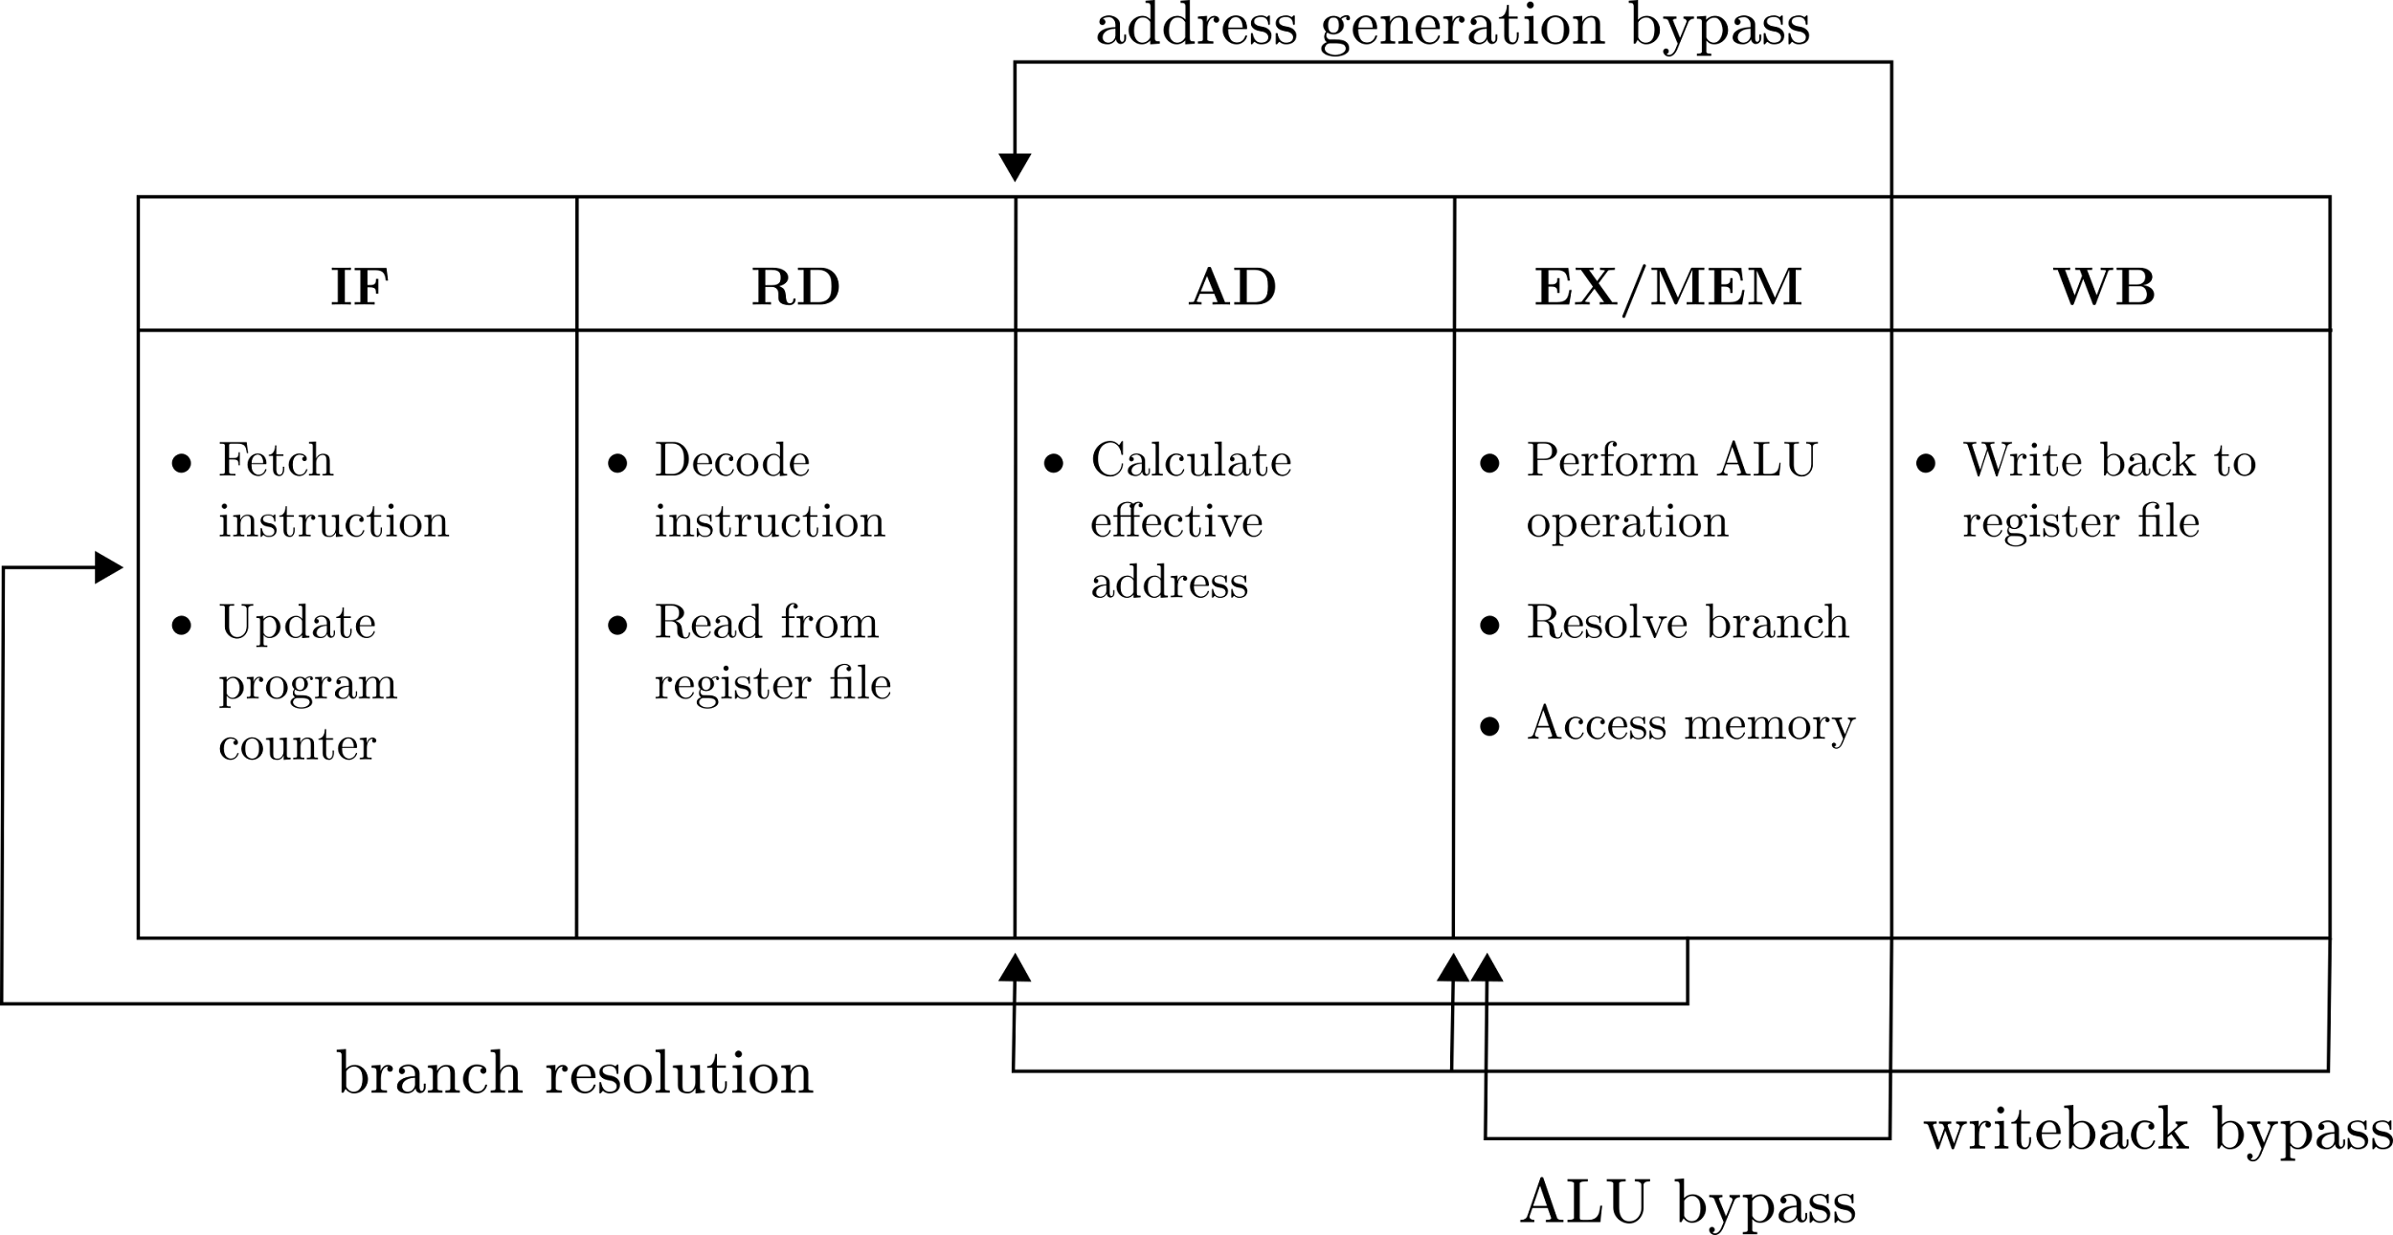
Address Generation Interlock
Based on: Golden and Mudge, A comparison of two pipeline organizations (1994)
Fill in the pipeline diagram (Advantages compared to original?)

Slide 15
 | 1 | 2 | 3 | 4 | 5 | 6 | 7 | 8 | 9 | 10 | 11 | 12 | 13 | 14 | 15 | 16 | 17 | 18 | 19 | 20 | 21 | 22 | 23 | 24 | 25 | 26 | 27 | 28 | 29 | 30
addi
add
lw
bne

Slide 16
Address Generation Interlock
What is the CPI for the pointer chase code on the AGI pipeline? (CPI is measured from when first instruction commits to when last instruction in the sequence commits)
What is the CPI if EX/MEM is split into M1 and EX/M2?
What is the CPI assuming the BNE is always predicted correctly?

Slide 17
Pipeline Comparison
Suppose that the LUI pipeline closes timing at 1 GHz. At what minimum frequency does the AGI pipeline outperform the LUI pipeline on this code sequence, assuming perfect branch prediction?
In what situations might you choose the AGI pipeline over the LUI pipeline?

Slide 18
Exceptions
Precise Exception Definition:
All instructions prior to the exception in program order have committed, and none of the instructions after (and including the faulting instruction) appear to have started.
Why are precise exceptions useful?
Why might one not want to always implement precise exceptions?

Slide 19
Exception Handling in RISC-V (M-mode)
Example: Misaligned address exception on a load
MEPC (exception PC) ← PC of the load instruction
MCAUSE (exception cause) ← 0x4 (i.e., load address misaligned)
MTVAL ← Exception-specific metadata (i.e., faulting address)
MPP ← Previous privilege mode
MPIE ← MIE; MIE ← 0: Disable interrupts (and save the previous value)
PC ← MTVEC (trap vector)
This all happens atomically - why?

Slide 20
In the Exception Handler
Preserve context
Swap stack pointer (x1) with MSCRATCH CSR (pointer to M-mode stack)
Spill as many registers as needed to memory
Decode exception cause, dispatch to correct handler
Emulate unaligned load
Issue two aligned loads and combine them together
Write result to the entry for rd in the saved register context
Restore registers
Read old register values back from the stack
Swap MSCRATCH to restore original stack pointer

Slide 21
Exception Return
Increment EPC
In this case, the instruction has been emulated, so no need to re-execute!
Execute MRET to return to previous privilege mode in MPP field
PC ← MEPC
MIE ← MPIE

Slide 22
Hazards
Structural hazards
Are there any structural hazards in a classic 5-stage RISC pipeline?
What modifications to the pipeline may introduce a structure hazard?
Data hazards
Control hazards

Slide 23
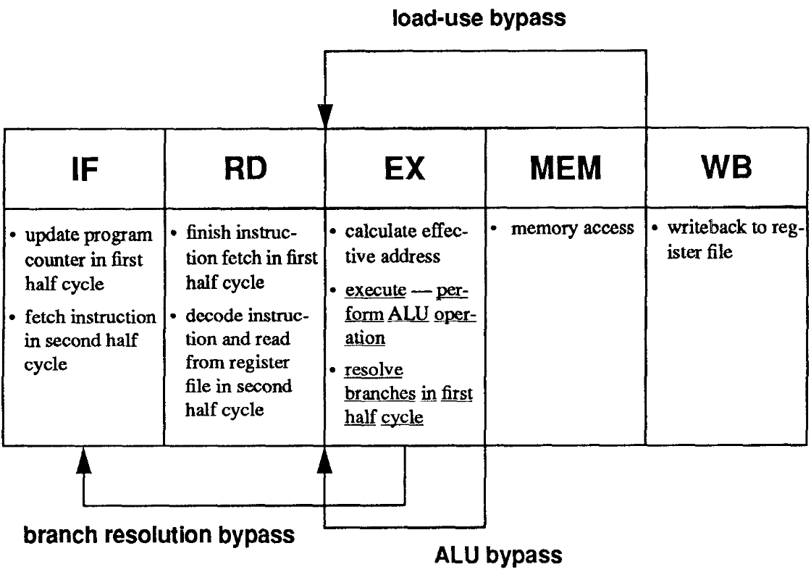
Classic RISC (Load-Use Interlock)
Fill in the pipeline diagram (What is the branch penalty?)
From: Golden and Mudge, A comparison of two pipeline organizations (1994)
Notes:
In some 5-stage implementations, PC redirection does not happen until the next cycle after branch resolution.

Slide 24
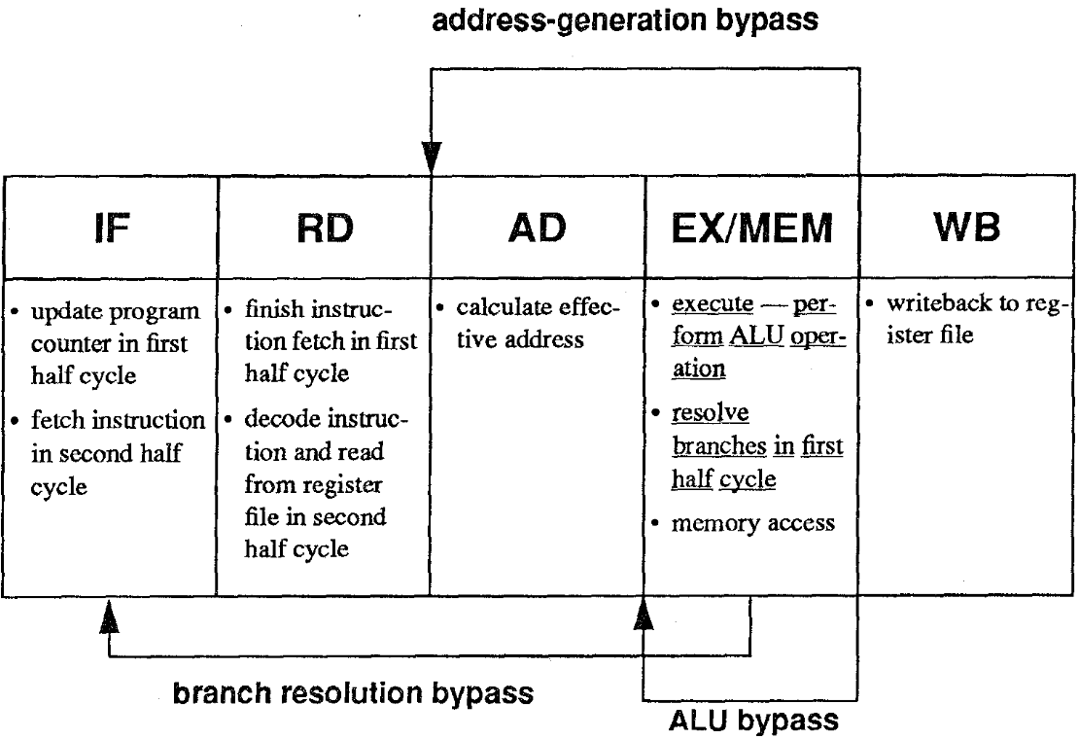
Address Generation Interlock
Fill in the pipeline diagram (Advantages compared to previous design?)
From: Golden and Mudge, A comparison of two pipeline organizations (1994)

